Slide 1
Walmart Data analysis
Sales analysis using SQL
04/06/2025

Slide 2
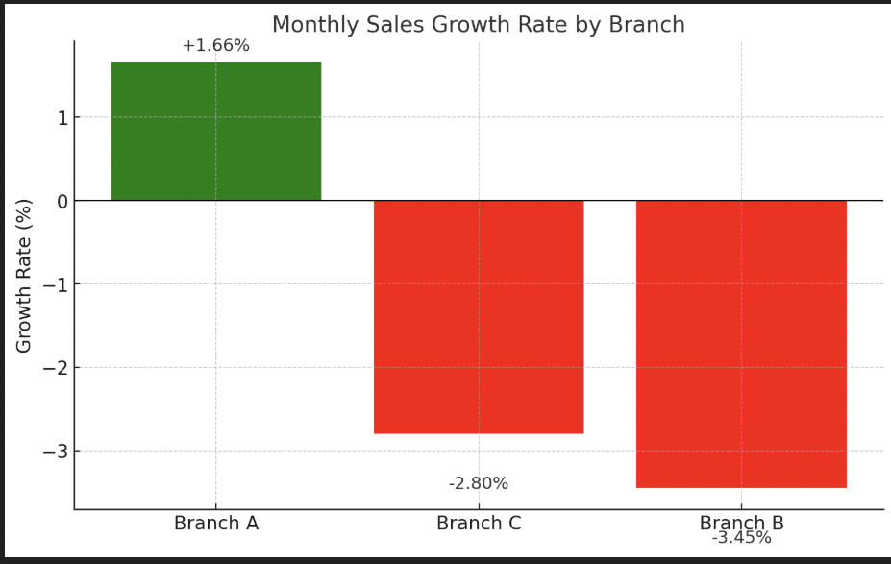
Branch by Sales Growth Rate
Branch A showed the highest positive sales growth, with an average monthly growth rate of +1.66%.
Branch C experienced a decline in performance, with a growth rate of -2.80%.
Branch B had the lowest performance, with a growth rate of -3.45%.

Slide 3
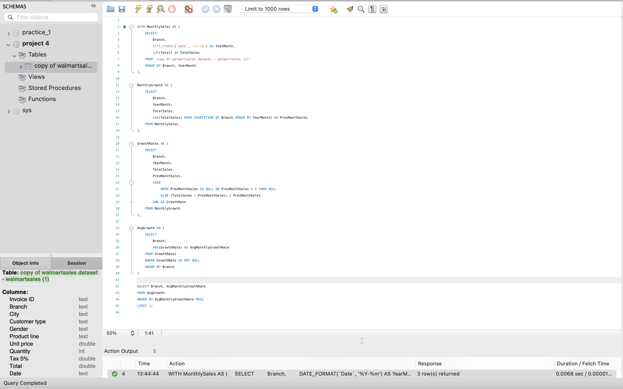
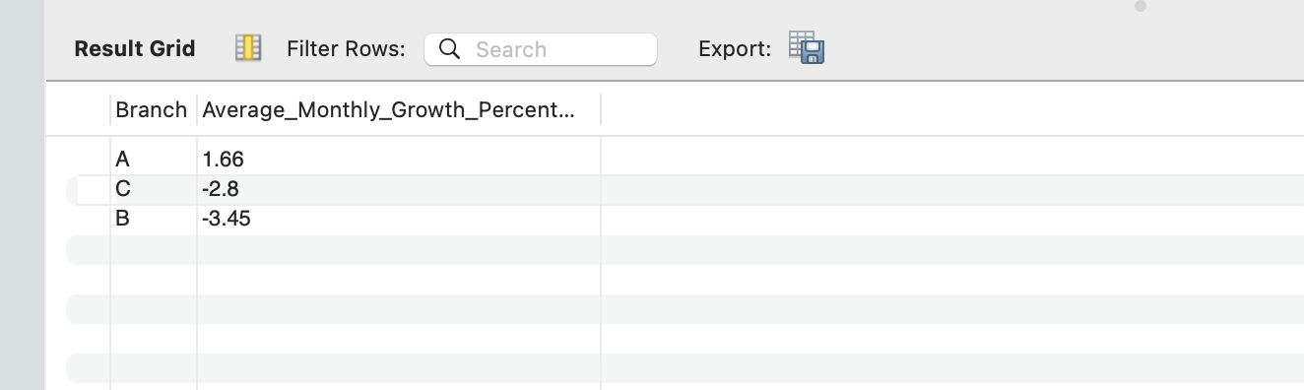
Code and Output

Slide 4
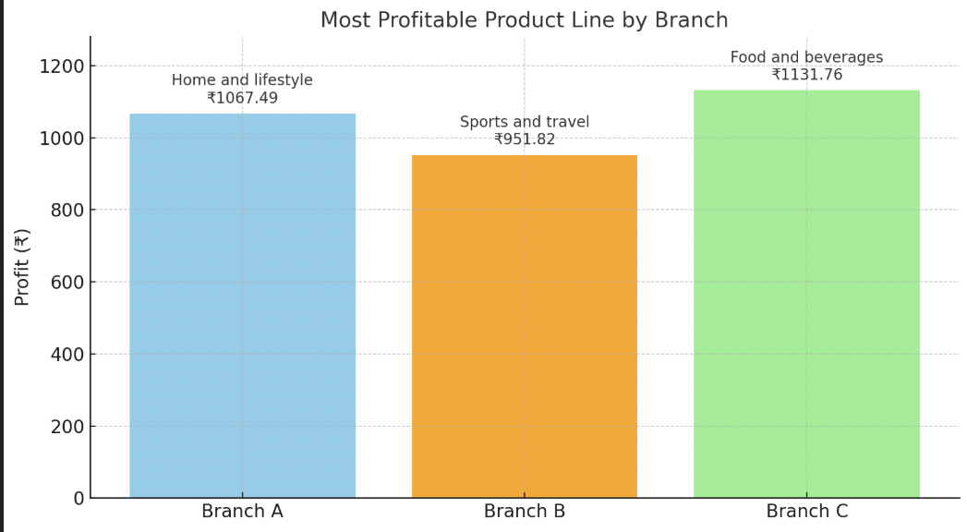
Most Profitable Product Line for Each Branch
Branch A: Most profitable product line is Home and lifestyle with a profit of ₹1067.49
Branch B: Most profitable product line is Sports and travel with a profit of ₹951.82
Branch C: Most profitable product line is Food and beverages with a profit of ₹1131.76

Slide 5
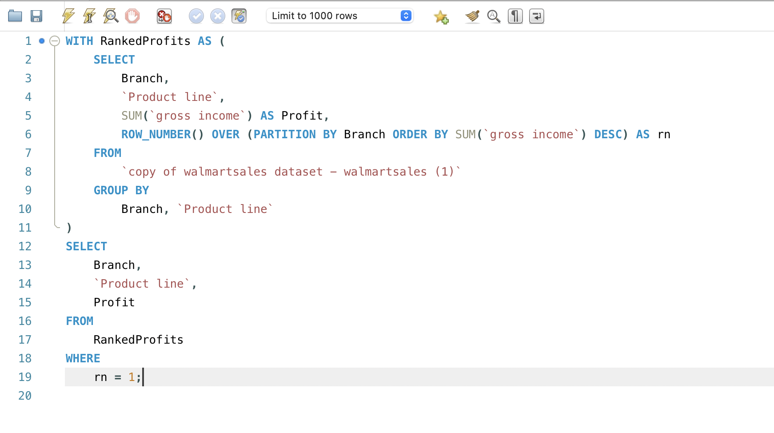
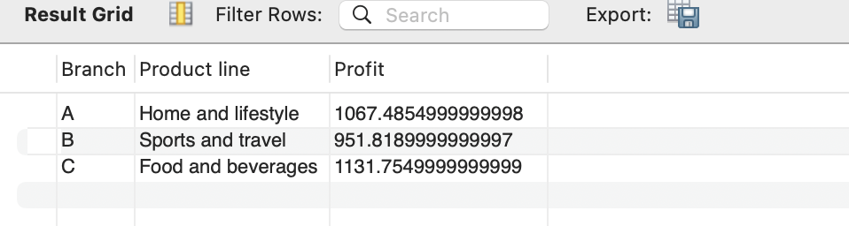
Code and OutPut

Slide 6
Customer Segmentation Based on Spending
High Spenders: These customers consistently spend more than the upper threshold and contribute significantly to total revenue. They are ideal targets for premium offers, loyalty programs, and exclusive discounts.
Medium Spenders: These customers have moderate spending patterns. They represent a stable base and can be nurtured with upselling strategies to move them into the high spender category.
Low Spenders: Customers in this group have minimal purchase activity. They may be occasional or price-sensitive shoppers and could benefit from targeted promotions or bundled offers.

Slide 7
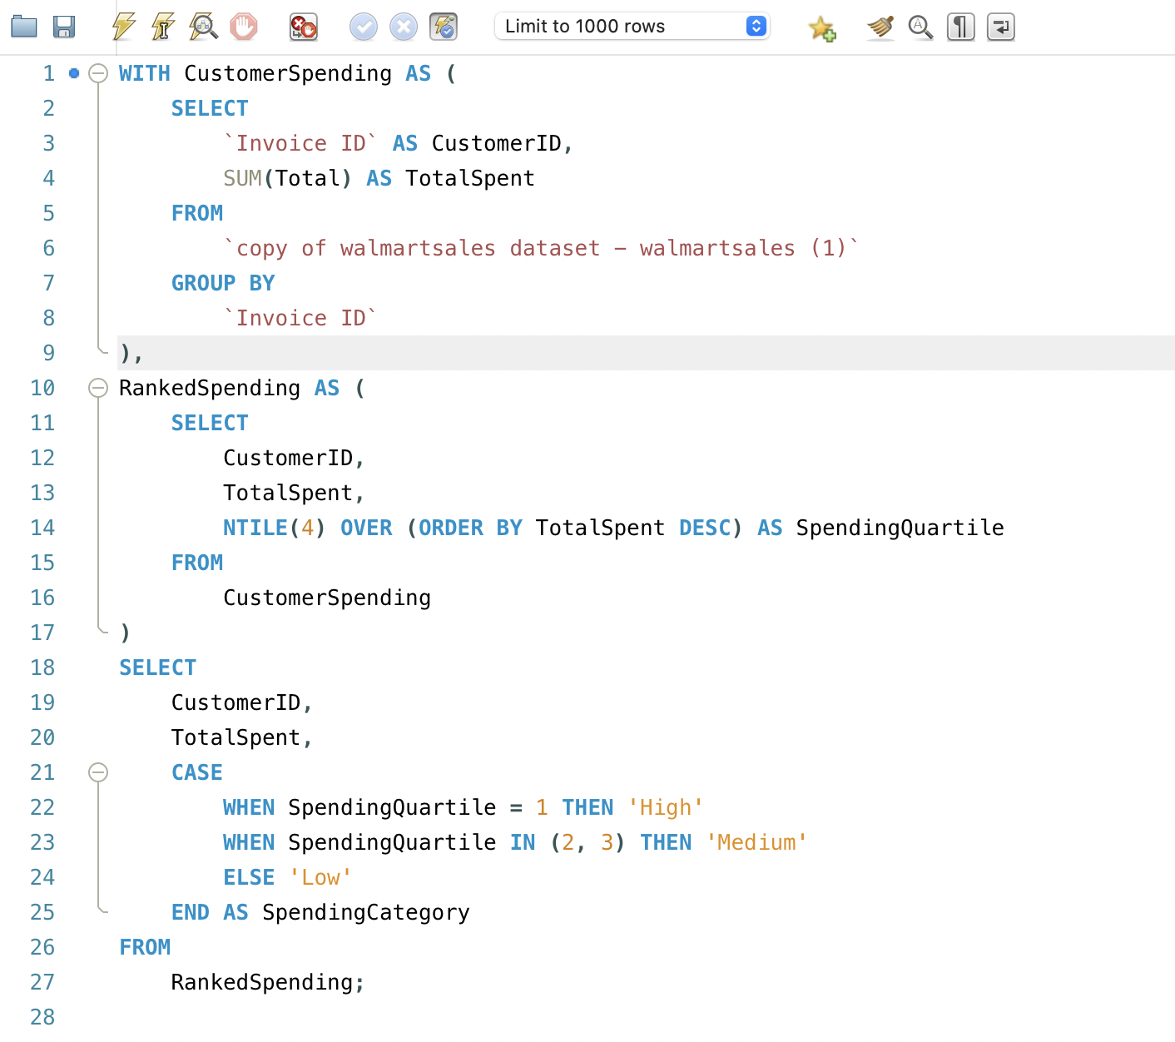
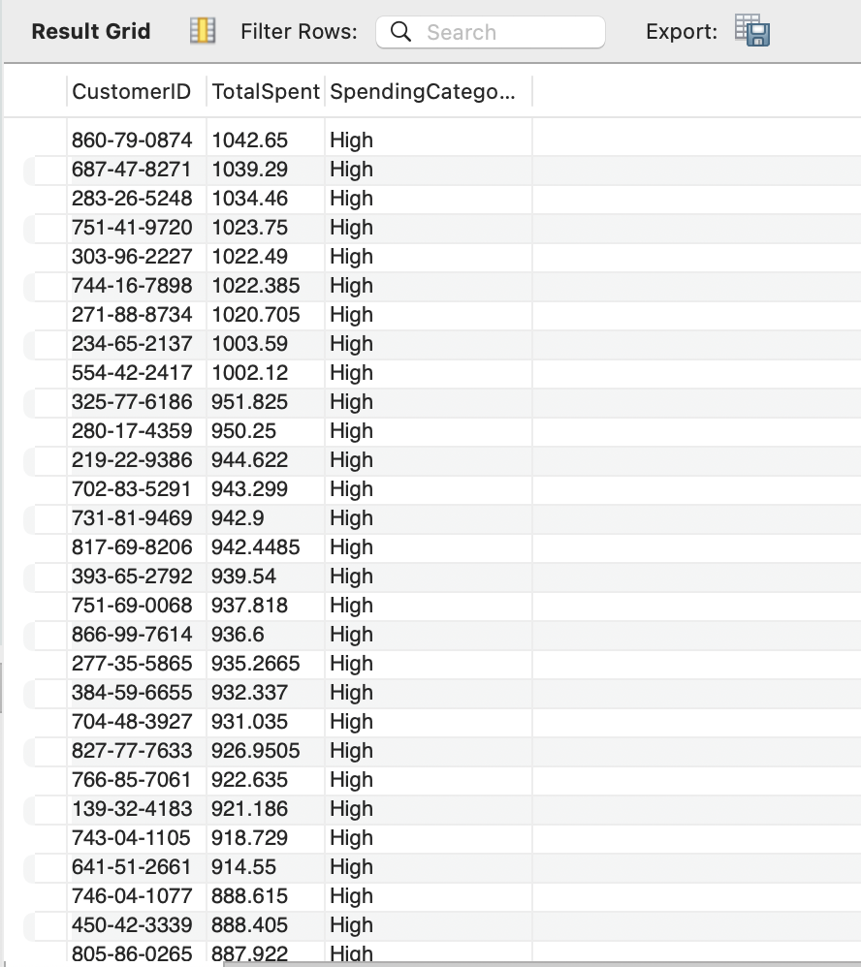
Code and OutPut

Slide 8
Detecting Anomalies in Sales Transactions
Analyzed individual transactions across product lines to identify unusually high or low sales values.
Used average (mean) and standard deviation of sales (Total) within each product line as benchmarks.
Transactions outside ±2 standard deviations from the mean were flagged as anomalies.
These anomalies may indicate data entry errors, suspicious activity, or unexpected purchasing behavior.
Enables Walmart to investigate outliers, improve data quality, and adjust pricing or promotional strategies accordingly.

Slide 9

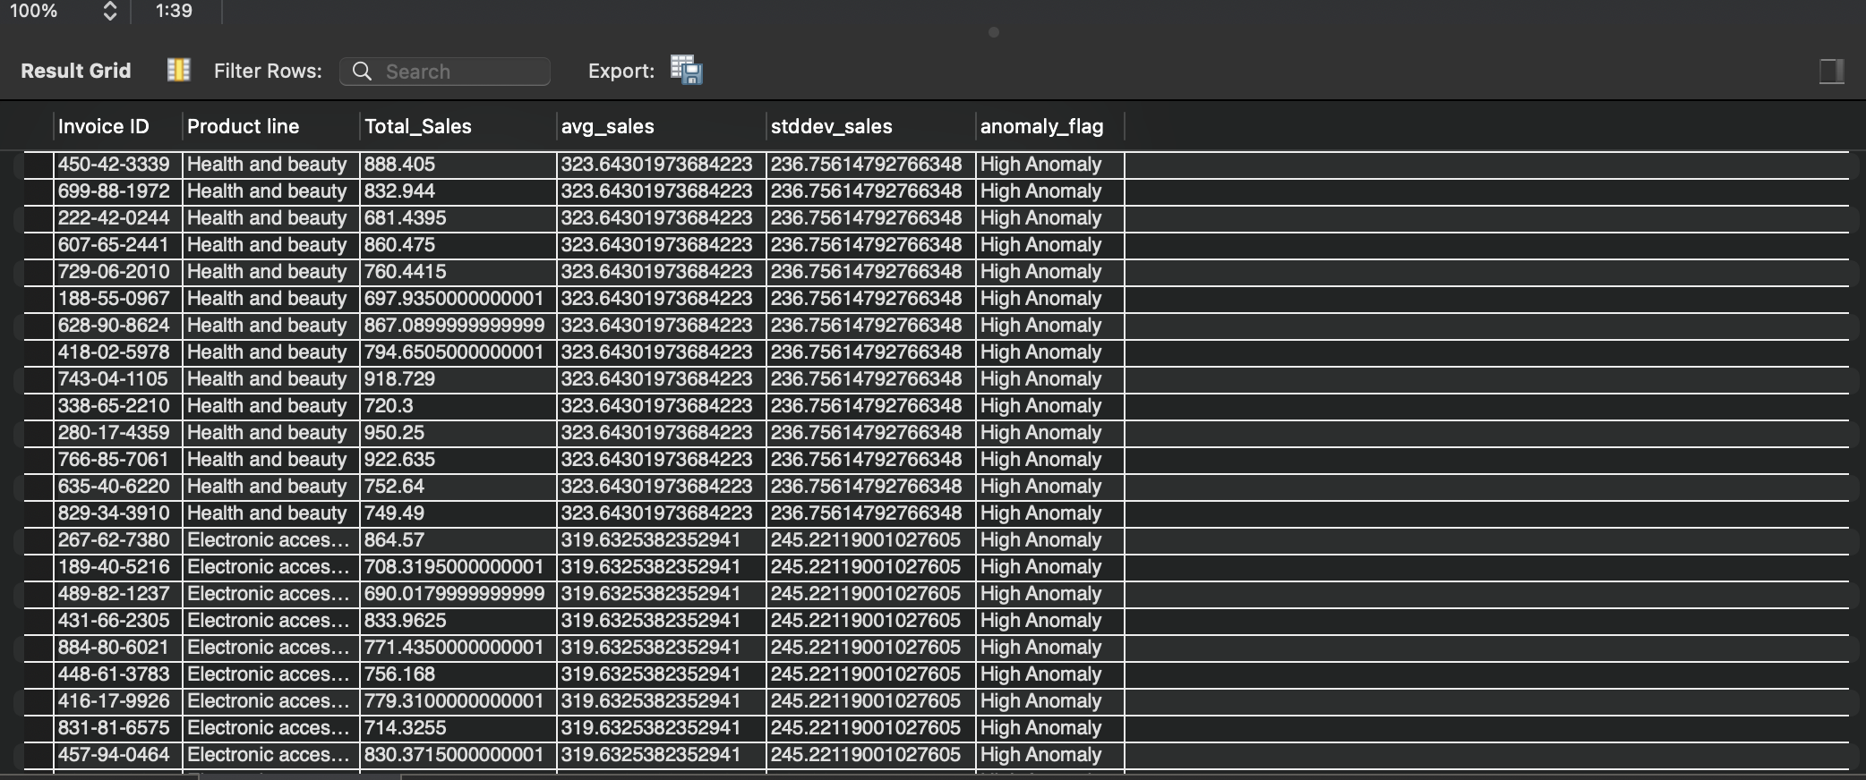
Code and OutPut

Slide 10
Most Popular Payment Method by City
Analyzed transactions to determine the most frequently used payment method in each city.
Compared usage of payment types such as Cash, Credit Card, and Ewallet across all cities.
Identified the top payment method in each city using count of transactions.
Helps Walmart tailor marketing strategies and enhance customer convenience by promoting preferred payment methods.
Supports strategic decisions like partnering with fintech providers or offering discounts on popular methods in specific regions.

Slide 11

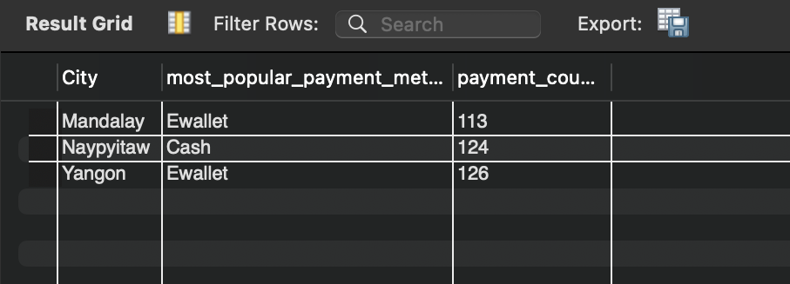
Code and OutPut

Slide 12
Monthly Sales Distribution by Gender
Analyzed sales data to compare monthly purchase behavior between male and female customers.
Grouped data by month and gender to identify sales trends over time.
Helps in understanding gender-based purchasing patterns and seasonal shopping behavior.
Enables Walmart to customize promotions, offers, and inventory planning based on gender-specific trends.
Supports data-driven marketing decisions, such as targeting high-sales months with gender-focused campaigns.

Slide 13
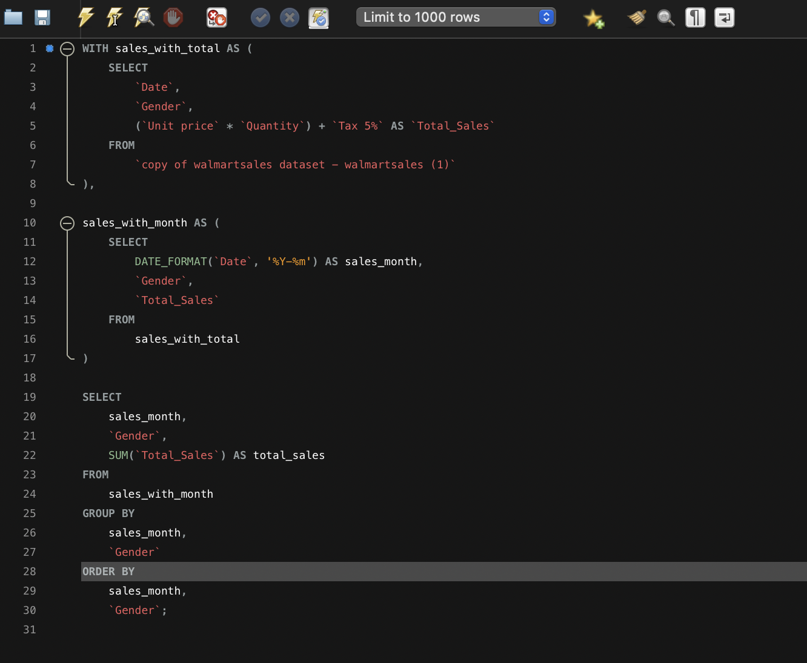
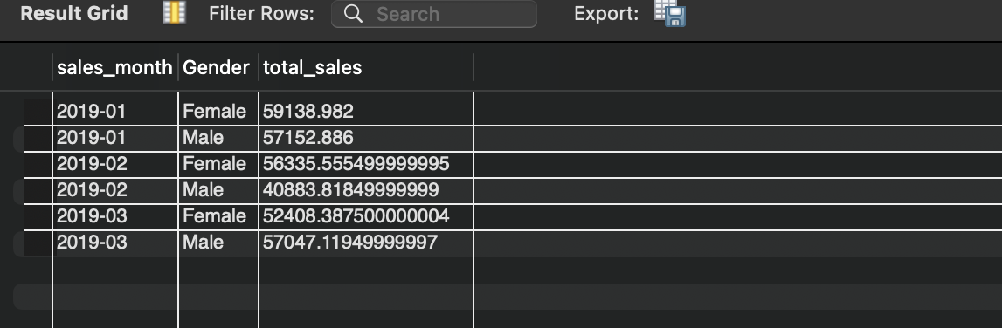
Code and OutPut

Slide 14
Product Line by Customer Type
Analyzed the total sales across product lines for each customer type (Member vs. Normal).
Segregated data using the Customer type and Product line columns.
Calculated total revenue (SUM of Total) for each combination.
Identified the most preferred product line by each customer type based on highest total sales.
Helps Walmart tailor promotions and inventory for targeted customer groups.

Slide 15
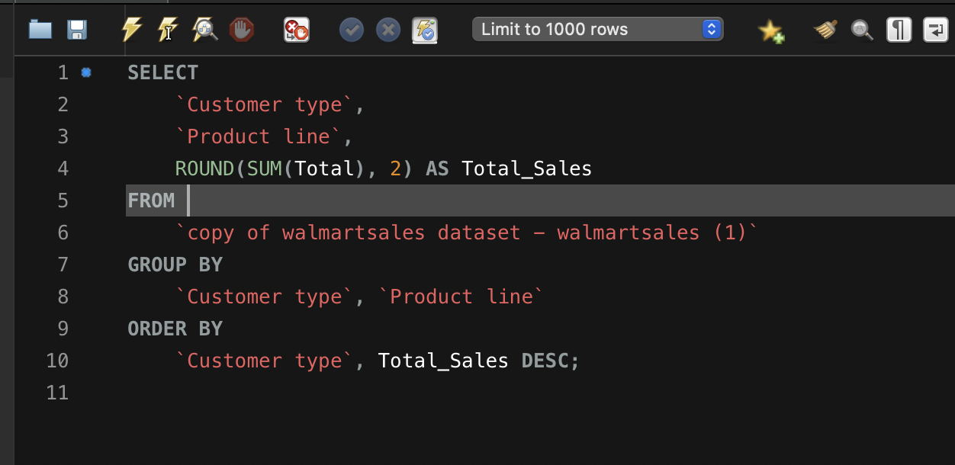
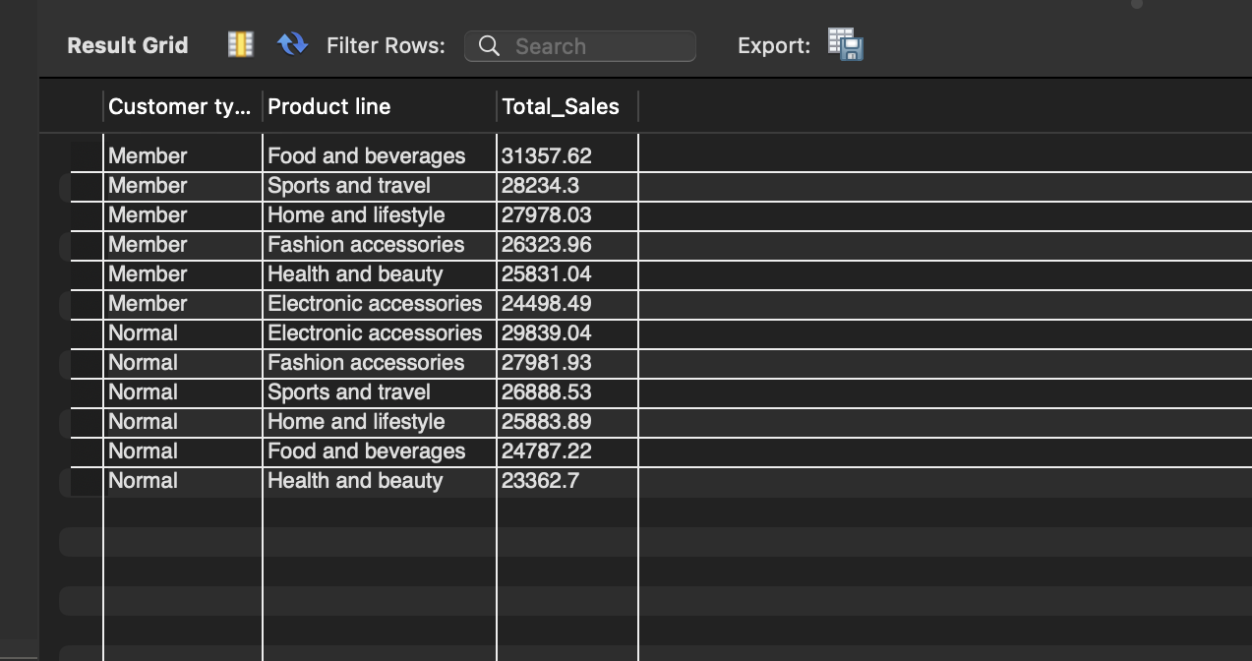
Code and OutPut

Slide 16
Repeat Customers
Analyzed transaction dates to detect repeat purchases by customers within a 30-day window.
Used window functions (LAG) to compare each purchase date with the previous one for the same customer type.
Calculated the number of days between transactions.
Flagged purchases made within 30 days as repeat behavior.
Insight: Helps identify loyal or returning customers, which can guide loyalty programs or remarketing strategies.

Slide 17
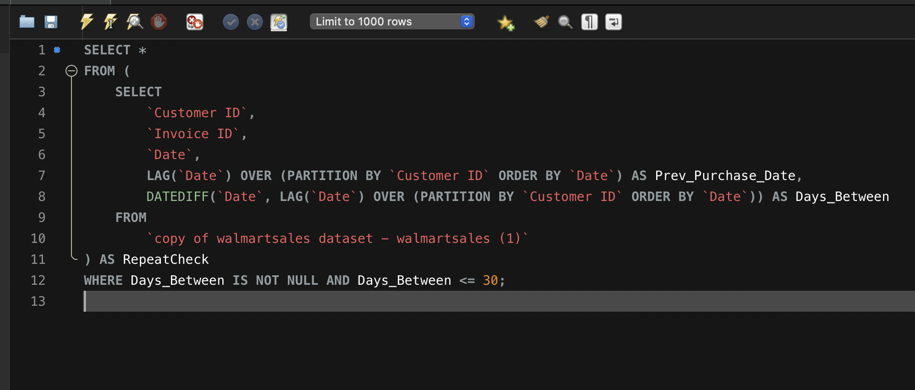
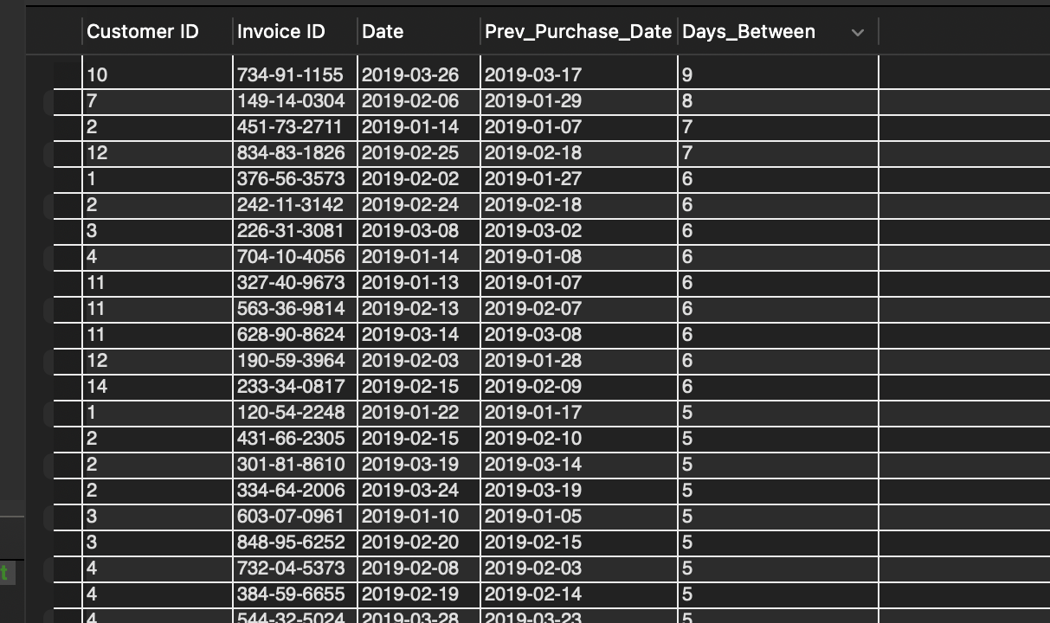
Code and Output

Slide 18
Top 5 Customers by Sales Volume
Identify the top 5 customers contributing the most to overall revenue
Used SUM(Total) to calculate total purchase amount per customer.
Sorted the results in descending order to highlight highest spenders.
Filtered top 5 using LIMIT 5.
These top customers can be targeted for rewards, loyalty programs, or VIP perks.

Slide 19
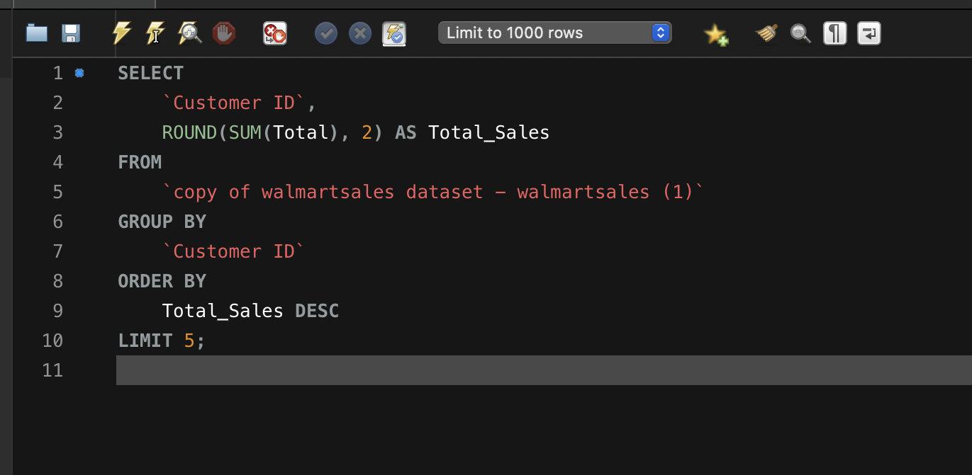
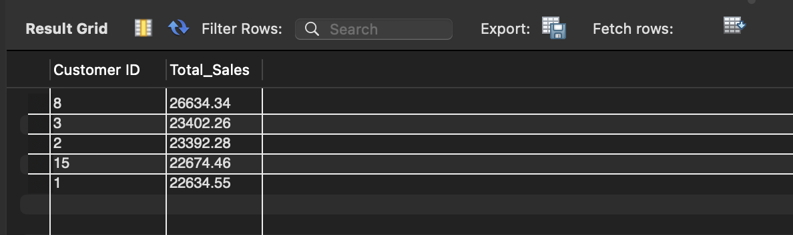
Code and Output

Slide 20
Analyzing Sales Trends by Day of the Week
Saturday is the most profitable day, with total sales of ₹56,120.81.
Tuesday follows with strong sales of ₹51,482.25.
Monday sees the lowest sales, totaling ₹37,899.08.
Weekends (Saturday and Sunday) perform better overall, indicating higher footfall or larger purchases.
The data helps Walmart plan marketing campaigns and promotions more effectively on high-traffic days.

Slide 21
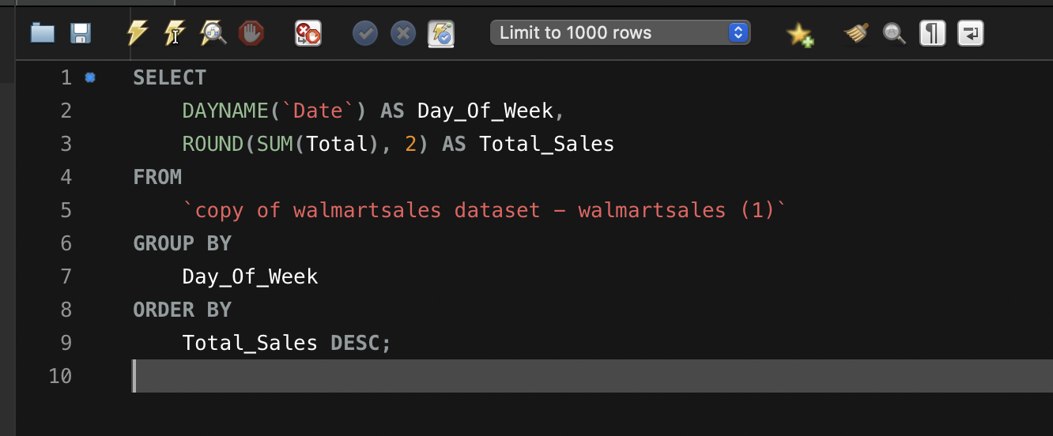
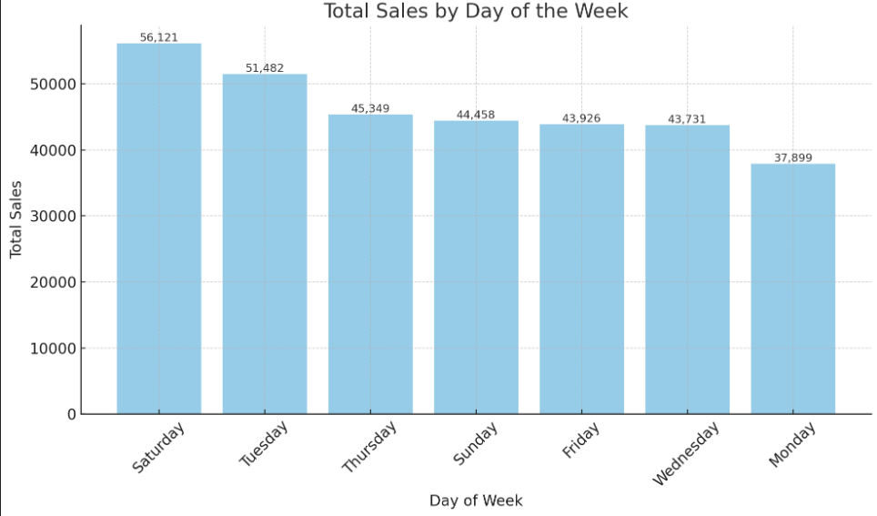
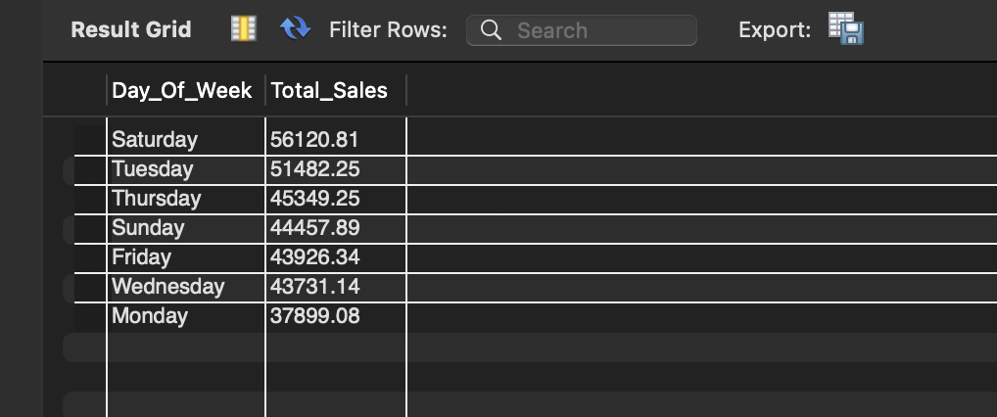
Code and OutPut

